Slide 1

Action-Packed Parcel Delivery
Matt Farrell
Johna Latouf
Orjan Monsen
Robert Tracey

Slide 2
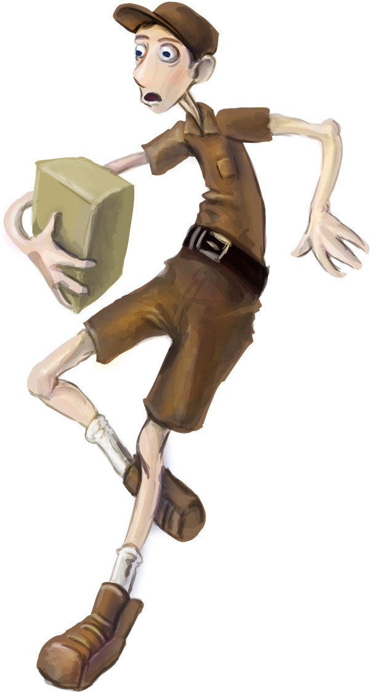
Premise
One Day Shipping is a fast-paced open-world package delivery game.
You control Larry Noodleman, fledgling employee of the One Day Shipping delivery company.
The game takes place over the course of Larry’s first week of work.
Notes:
ROB
One Day Shipping is a fast-paced open-world package delivery game.
You play as Larry Noodleman, a young man with the unfortunate problem of having long, lanky, elastic limbs his entire life. Because of his condition, Larry has never been able to hold down a steady job.
Now Larry has a chance to redeem himself at the city’s newest package delivery company: “One Day Shipping”. Larry is the first delivery man for the new company and so the company’s success falls squarely on his shoulders.
The game takes place over the course of a single work week, where each day ramps up the challenges in Larry’s way. This creates a simple narrative structure where each day begins with a cutscene that explains the story’s progression, and then the gameplay elements are reflected in these story changes.

Slide 3

Secondary Characters
The Dispatcher: A cranky old chain-smoker who is your eyes and ears.
She provides you with all the goings-on, and will talk to you during missions.
Notes:
ROB
The Dispatcher is character serves two roles in the game. She acts as your Onboarding guide, telling you about different objects in the world.
She will also deliver information as to what is happening in the story.
This is done through timed and triggered events: get close to an enemy for the first time and she’ll tell you to watch out. Half way through a mission she may tell you about what is happening at the office.

Slide 4
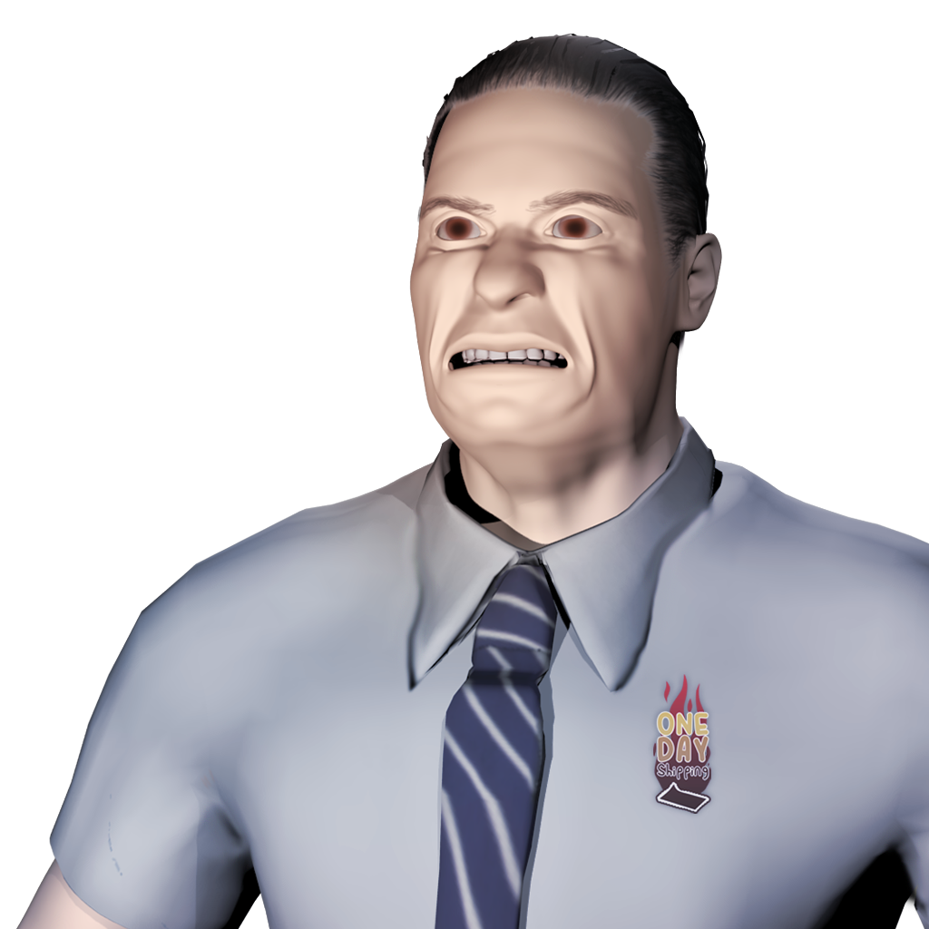
Secondary Characters
The Boss: Owner of One Day Shipping.
An entrepreneur from a long line of entrepreneurs.
He challenges you to do better.
Notes:
ROB
Owner of the One Day Shipping package delivery service, and local entrepreneur. The Boss comes from a family tradition of loud-mouthed employers. His sole goal is to make sure his new company becomes the greatest delivery service in the world.
Where the dispatcher is your confidant, the boss is the character who drives you to do better. Critiquing you if you take too long to complete a task, or failing to delivery all of the packages.

Slide 5
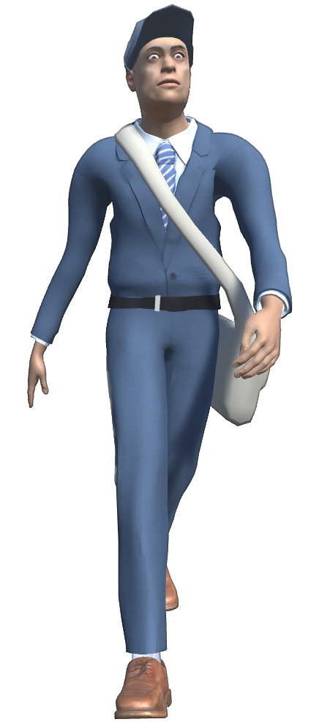
Secondary Characters
The Postal Service: A shady organization that holds a monopoly over the package delivery world.
They don’t take kindly to people stepping on their turf.
Notes:
ROB
The postal service is our game’s primary antagonist.
This organization does has held dominant over the postal world for generations, stomping out all of their competition.
As the narrative of the game progresses, the postal service becomes ever more desperate to stop your success, leading to a climactic postal war.

Slide 6
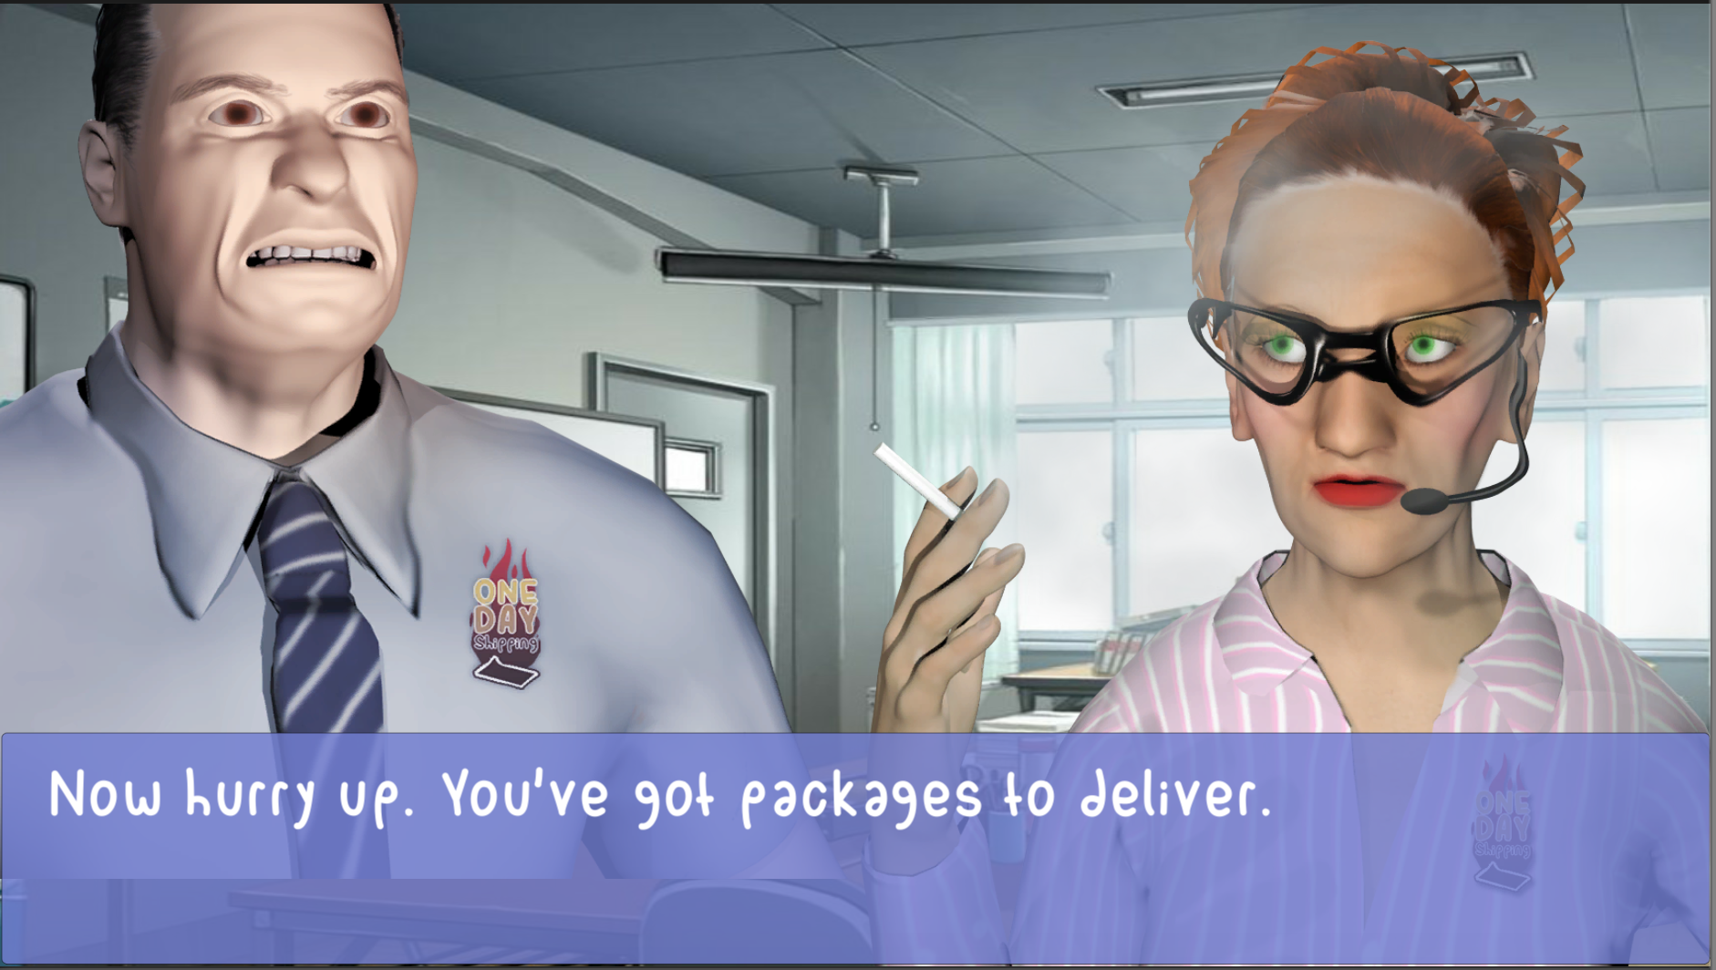
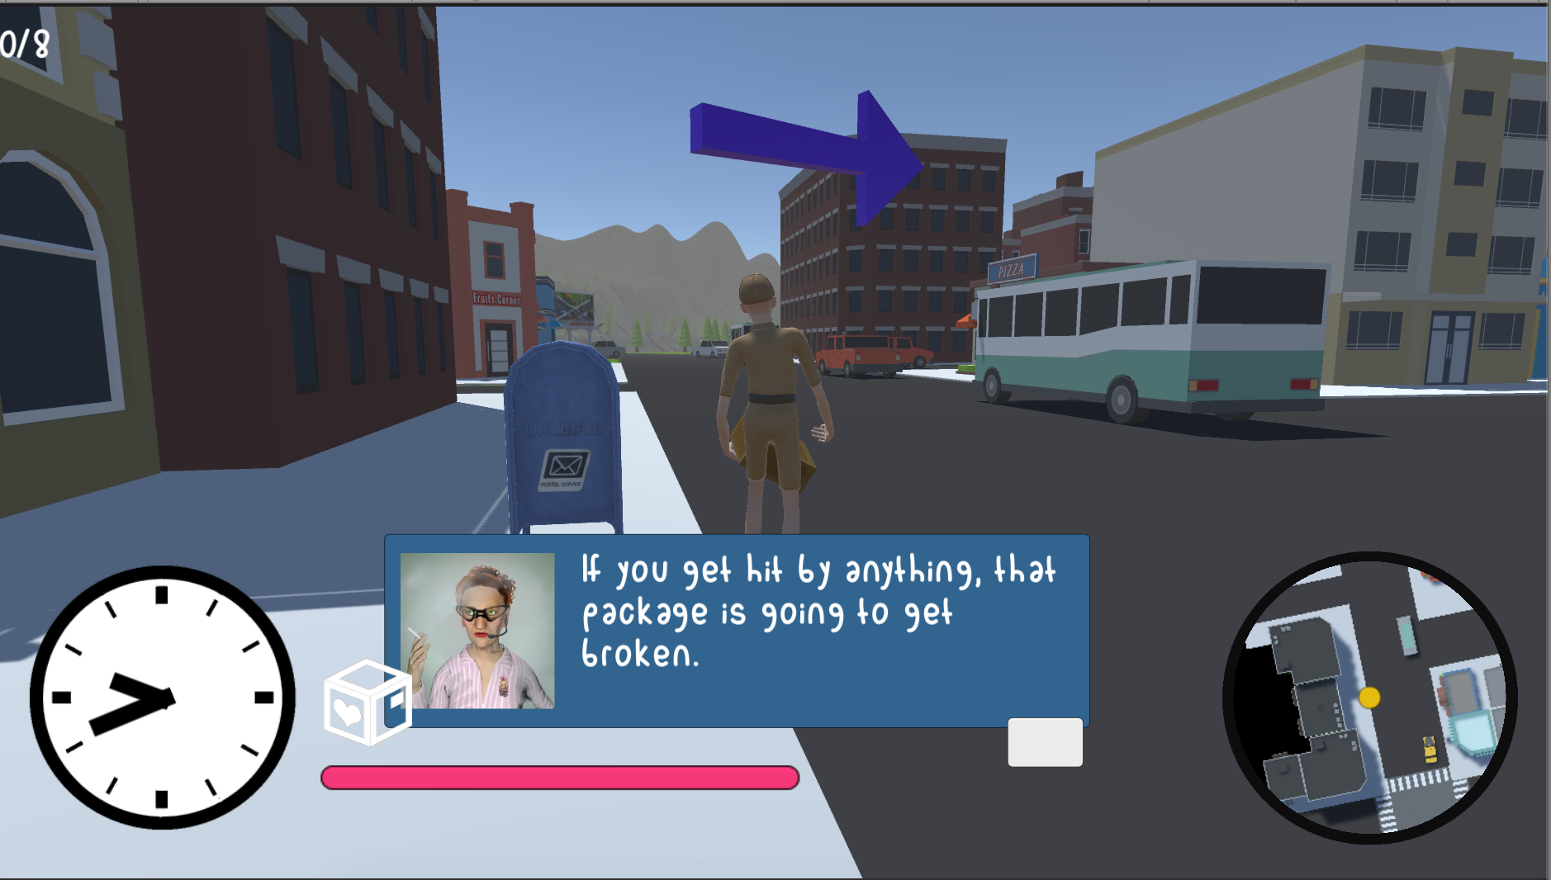
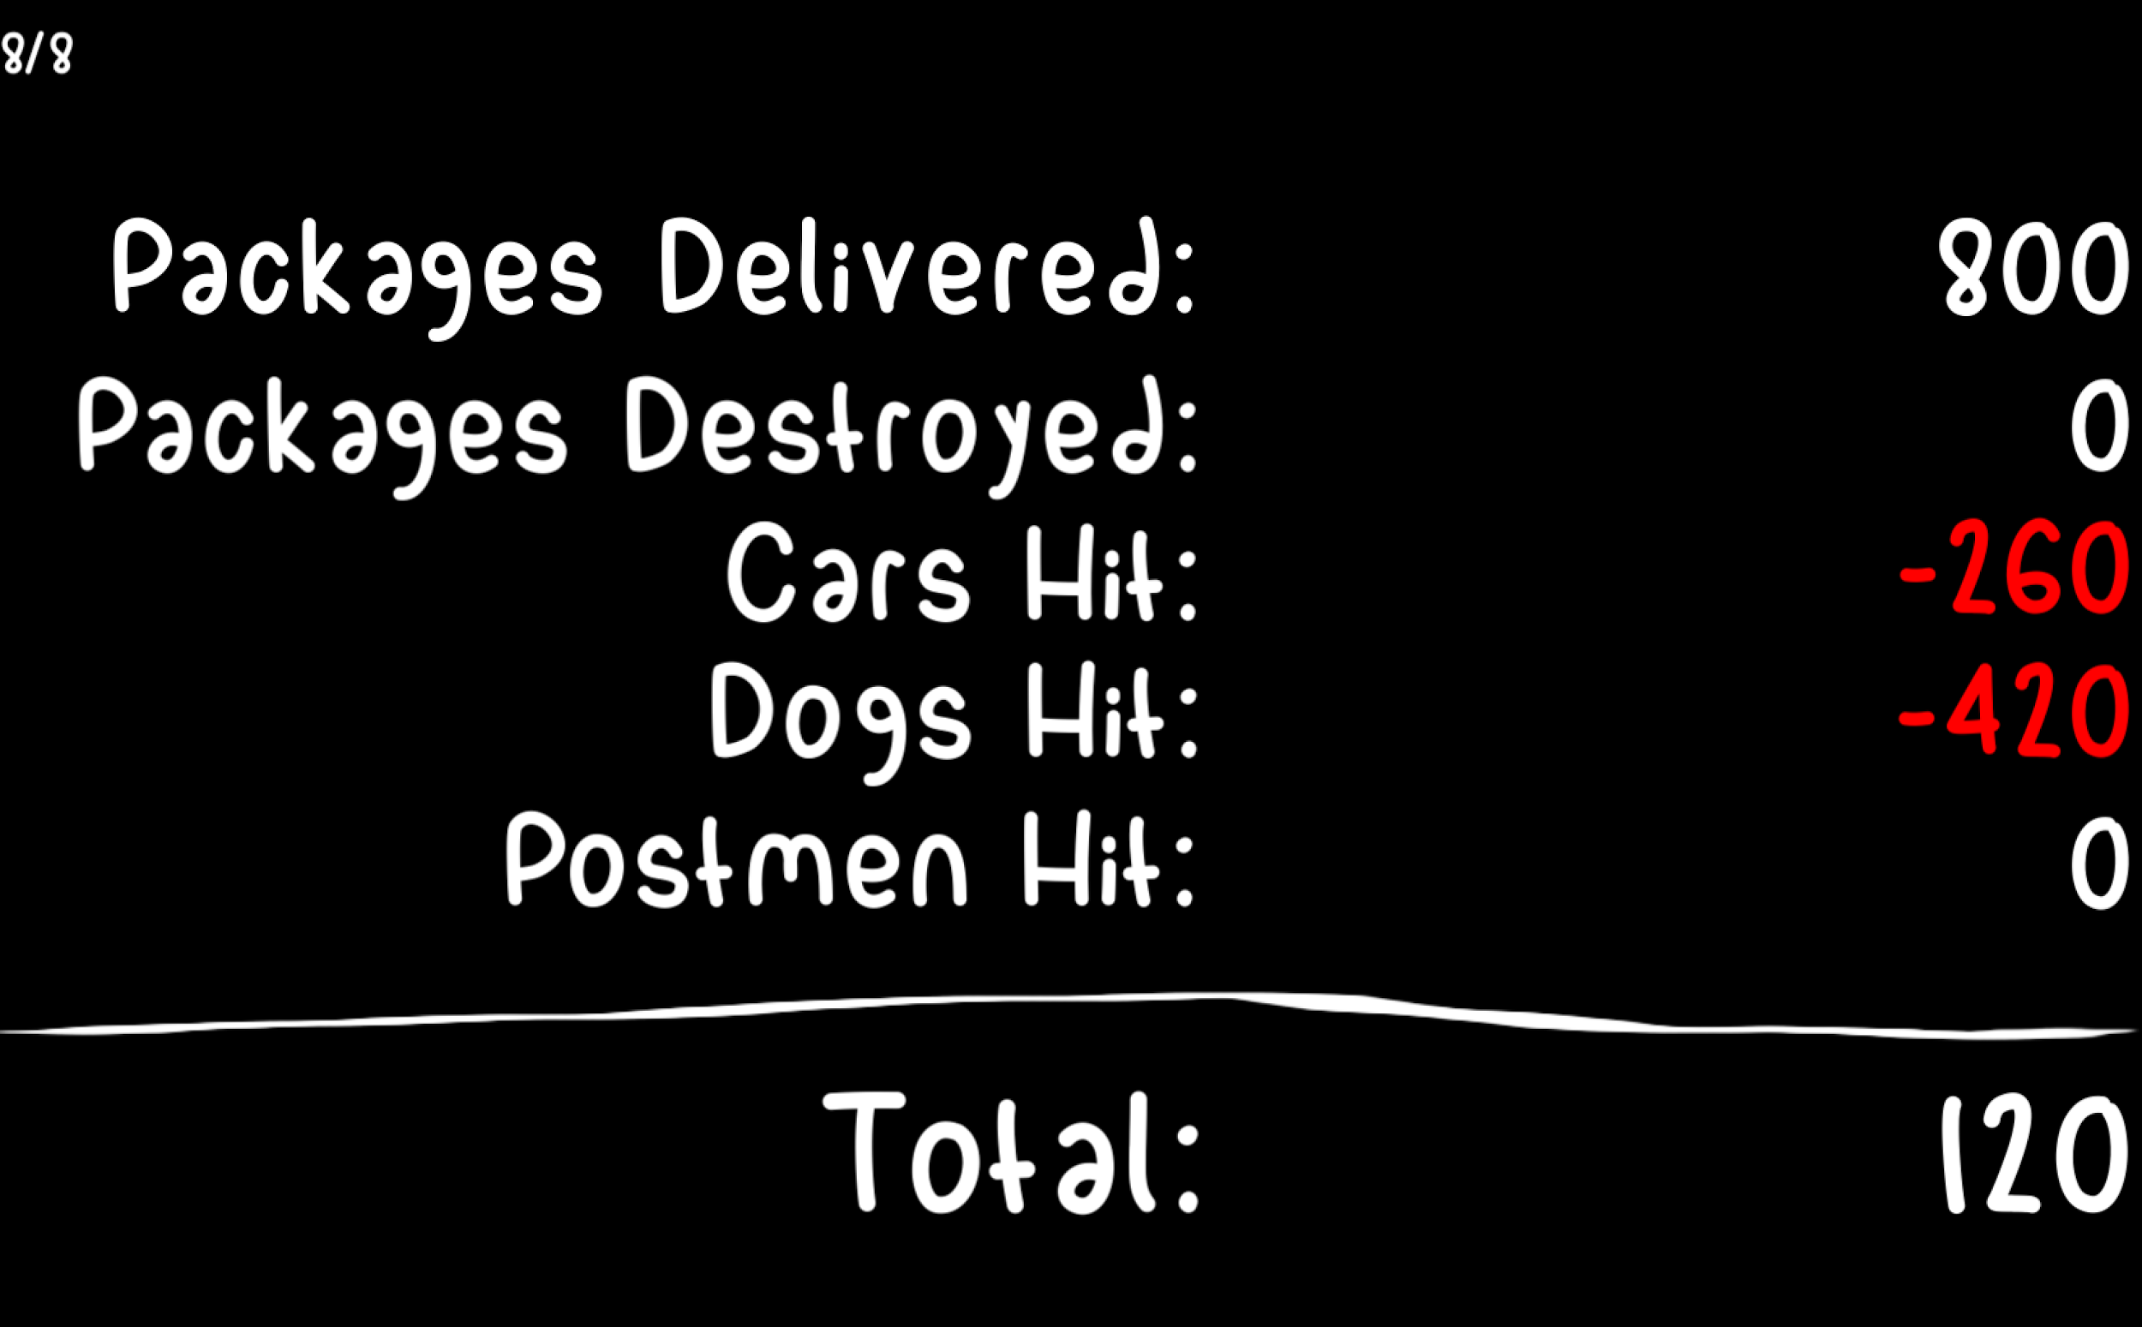
Story Progression
Cutscene
In-Game
Results Screen
Notes:
ROB
The postal service is our game’s primary antagonist.
This organization does has held dominant over the postal world for generations, stomping out all of their competition.
As the narrative of the game progresses, the postal service becomes ever more desperate to stop your success, leading to a climactic postal war.

Slide 7
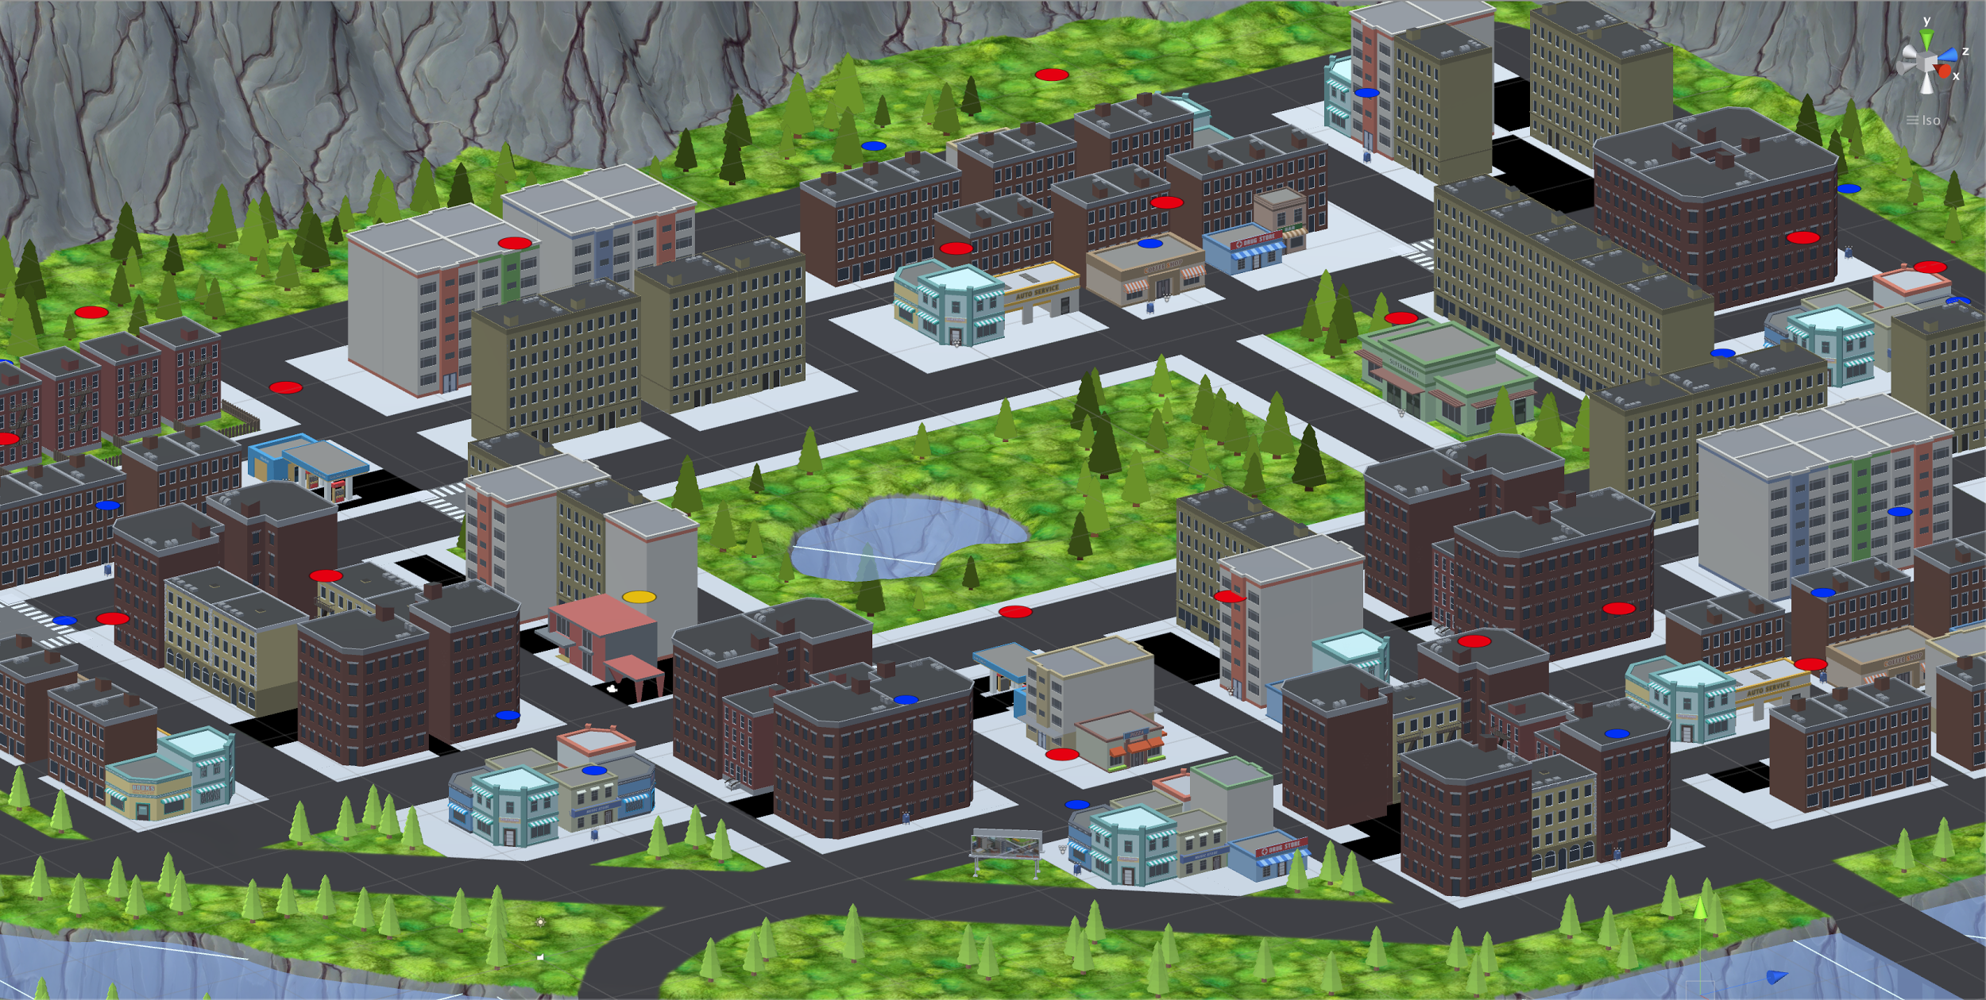
Game World: The City
Notes:
Matt

Slide 8
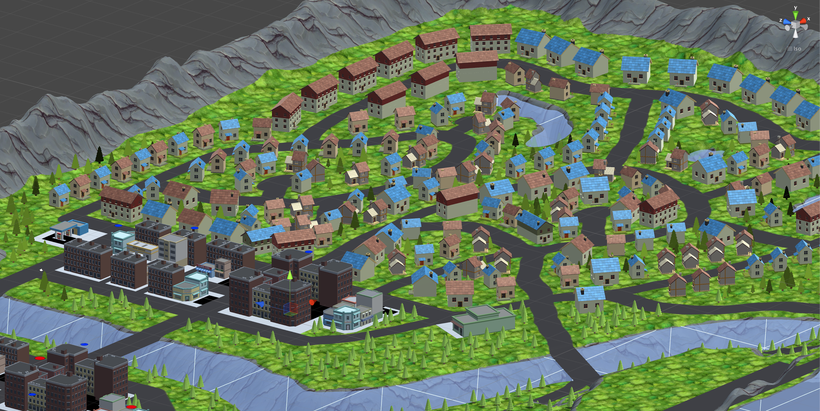
Game World: The Suburbs
Notes:
Matt

Slide 9
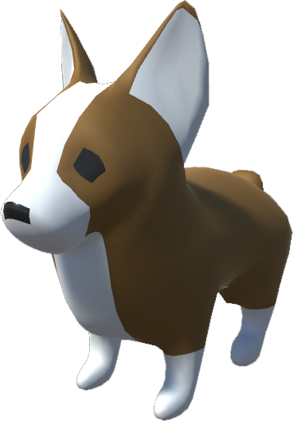
User Interface
Game Clock counts from 9am - 5pm.
Mini-Map for navigation.
Overhead arrow points to the next destination.
Package damage meter.
In-game dialogue box for onboarding and story progression.
Notes:
Matt

Slide 10
Replayability
Per-level scoring system.
Levels become available to replay as you complete them.
Keeps track of the high score per level.
Notes:
Matt

Slide 11
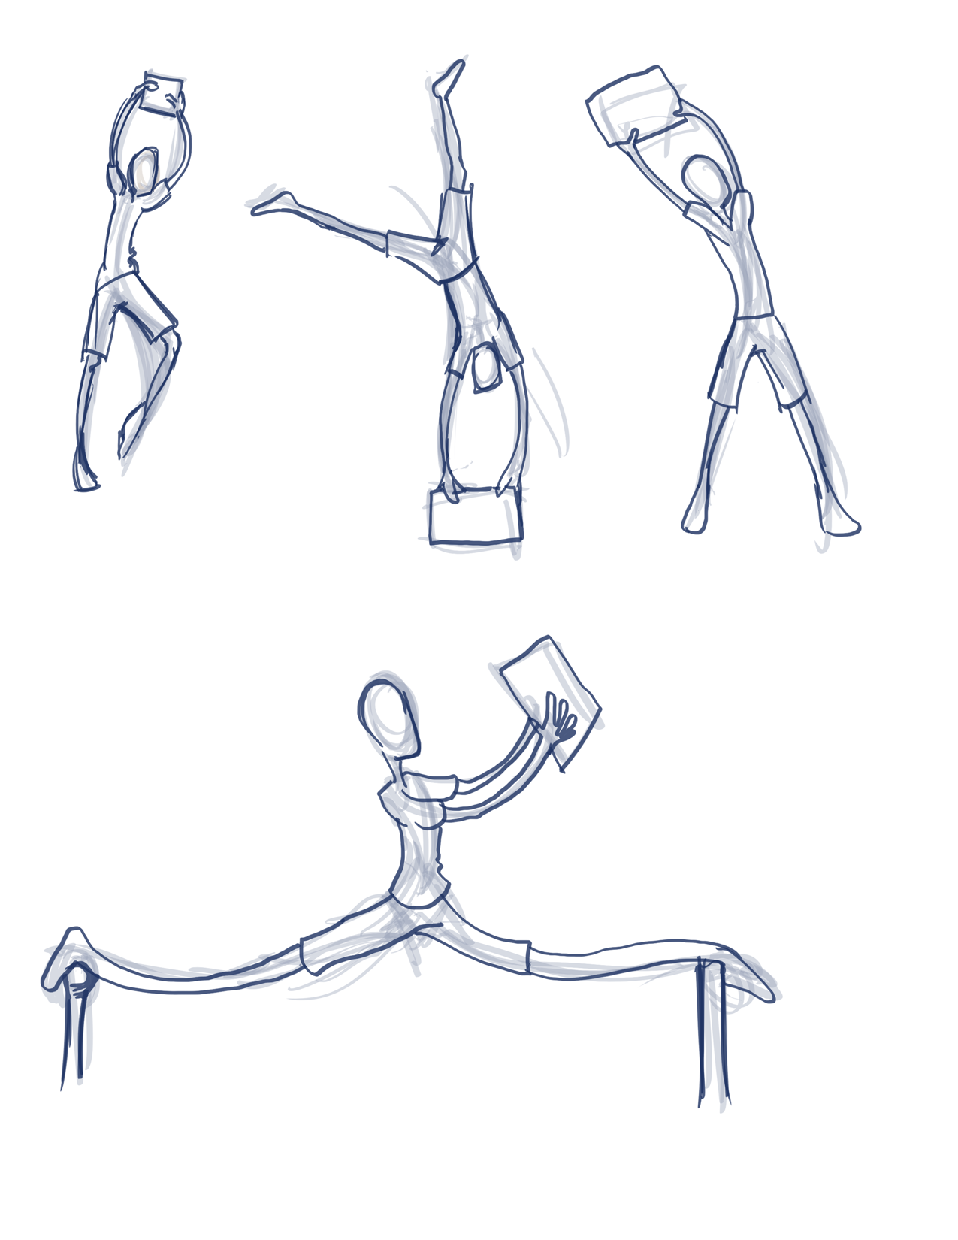
Design
Low-Poly art style.
Characters from MakeHuman.
Additional Assets modelled in Blender.
Unity’s Terrain Tool for the World.
Terrain Splat Maps & UI elements in GIMP.
Notes:
ROB

Slide 12
Challenges:
Open Worlds…
… Take a long time to make.
… Need a lot of Game Objects.
… Take a long time to render.
… Need to feel alive.
Notes:
ROB

Slide 13
Future Work
More levels. Larger variety of gameplay mechanics.
Power-ups.
Better vehicle collision mechanics and spawning.
A larger variety of enemies.
More lankiness.
Notes:
ROB

Slide 14
Demo

